Slide 1
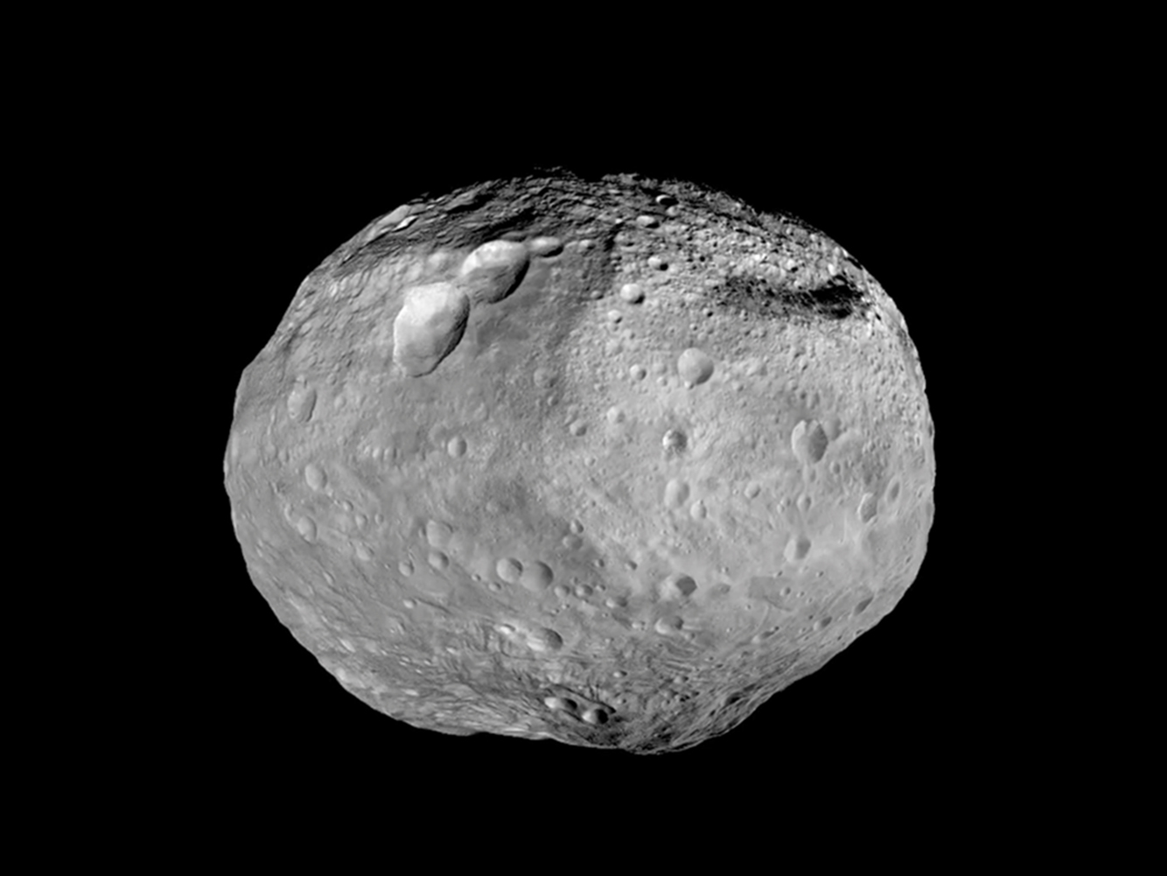
Vesta

Slide 2
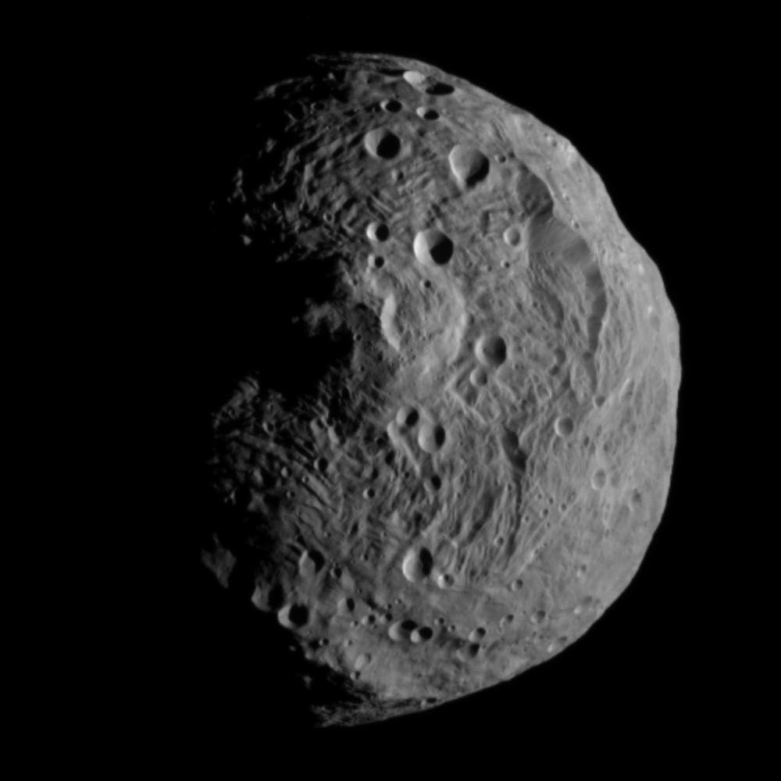
Vesta
Brightest asteroid visible in the sky
2nd largest asteroid

Slide 3
Vesta
Distance from Sun:
219 million miles (2.36 AU)
Orbital Period:
3.63 years

Slide 4

Vesta
Diameter: 290 miles
(although it is not completely spherical)
Surface Area:
About 500,000 square miles (about the size of Pakistan)

Slide 5
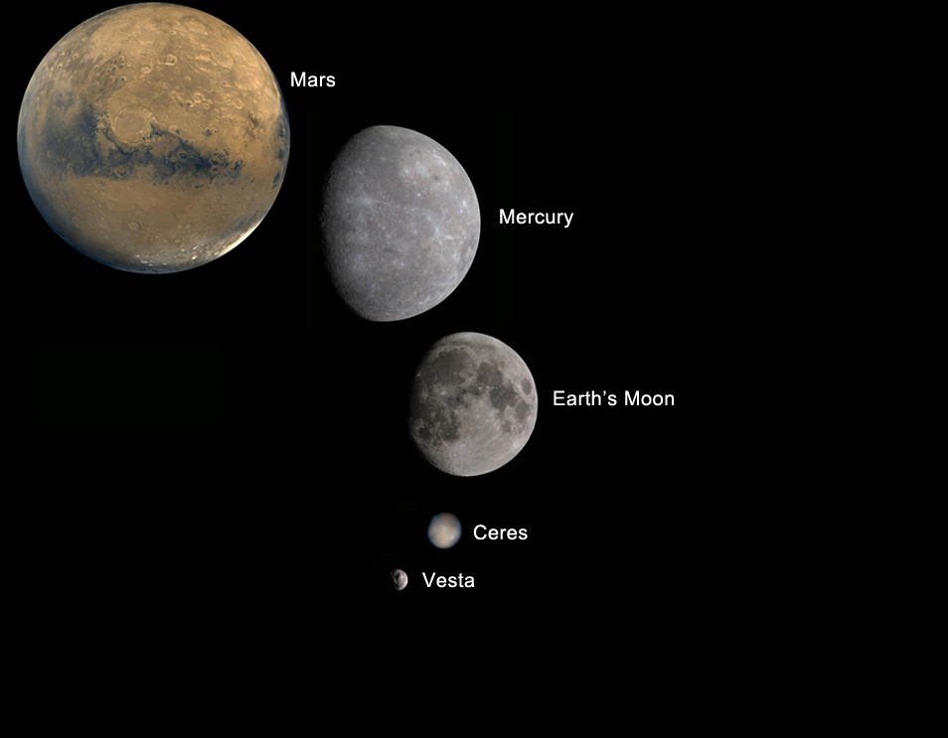

Slide 6
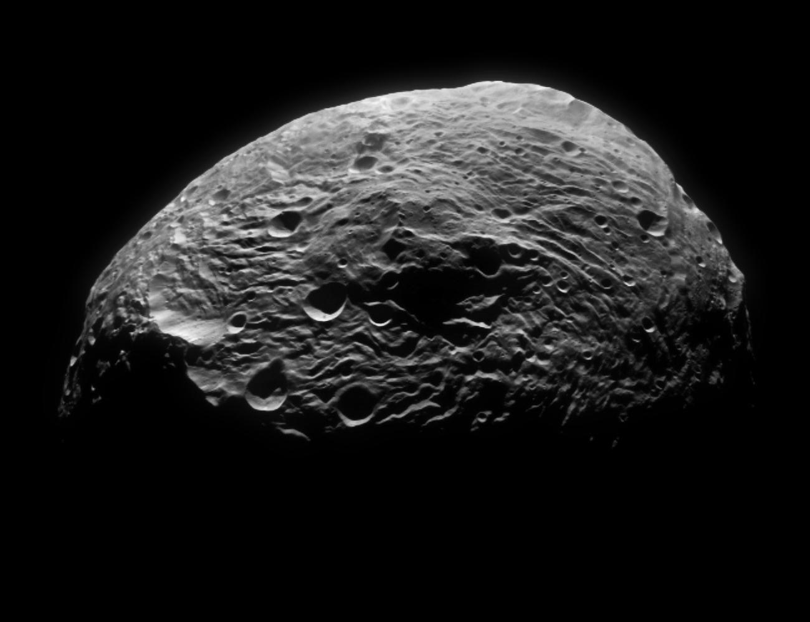
Temperature on surface:
-4⁰ F to -310⁰ F
Vesta

Slide 7
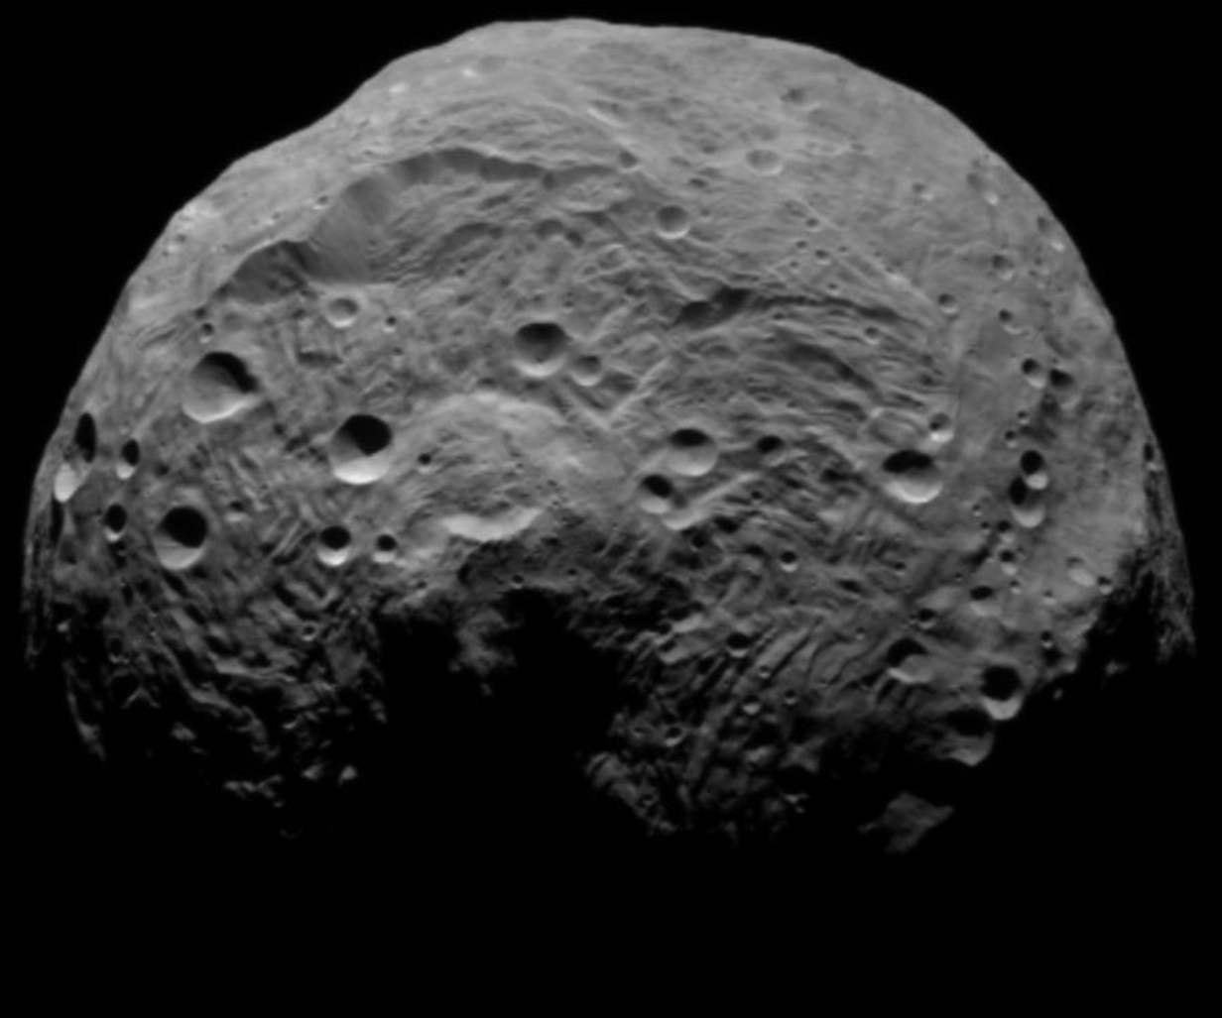
Vesta was discovered by Heinrich Wilhelm Matthias Olbers on March 29, 1807. He had previously discovered the asteroid Pallas in 1802. Pallas was the 2nd asteroid discovered. Vesta was the 4th.

Slide 8
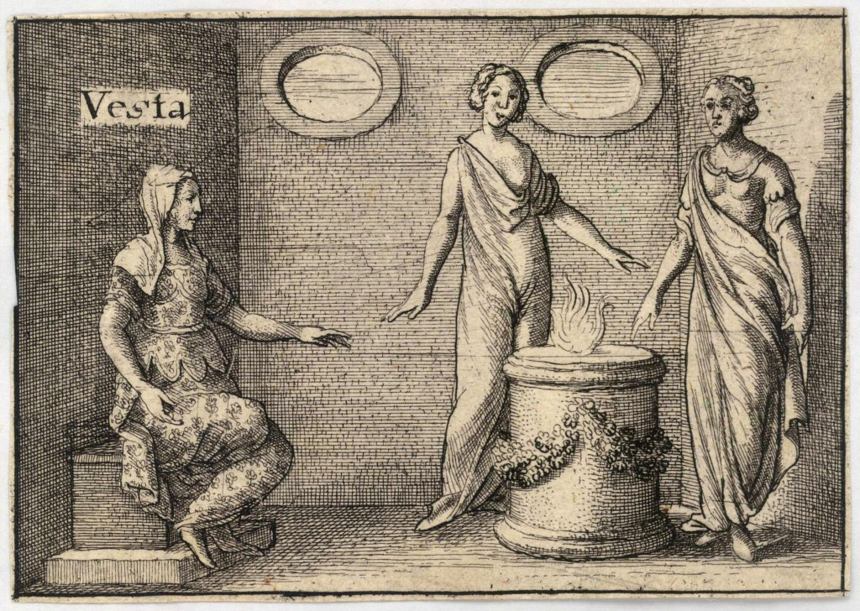
Vesta is named after the Roman goddess of hearth, home and family.

Slide 9
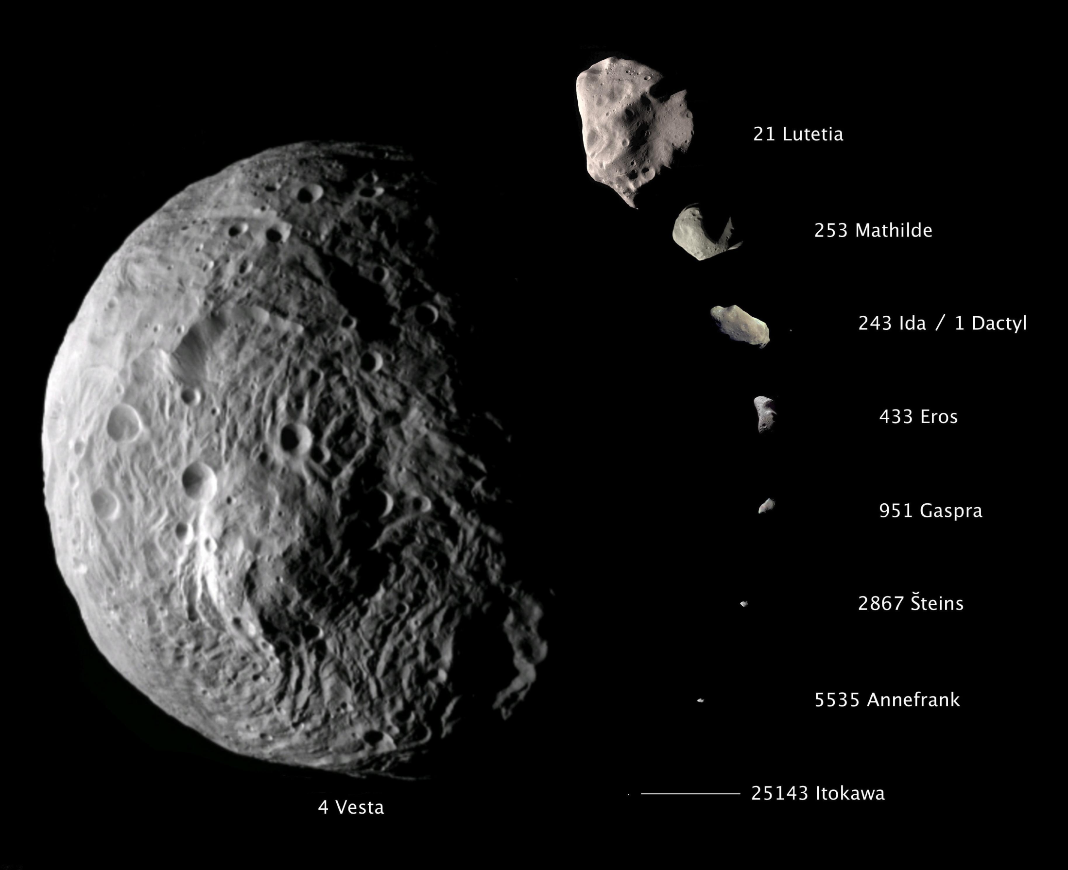
Vesta contains almost 10% of all the mass in the asteroid
belt.
Vesta

Slide 10
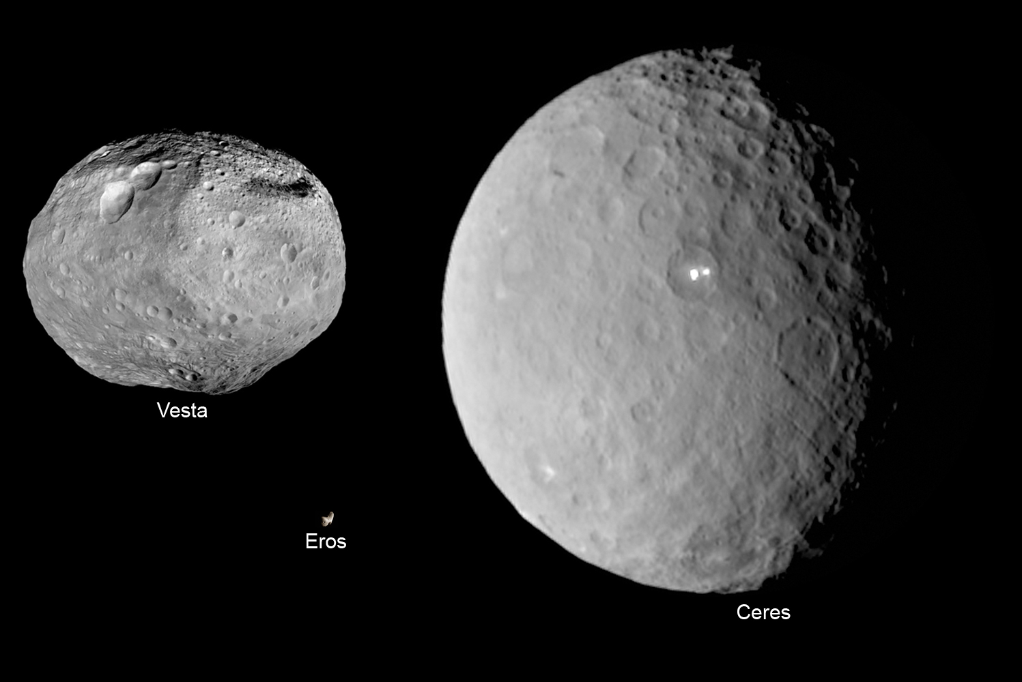

Slide 11

Vesta contains the Rheasilvia Crater, one of the largest craters in the solar system. It stretches 313 miles across, covering 90%
of the
length
of the
asteroid.

Slide 12
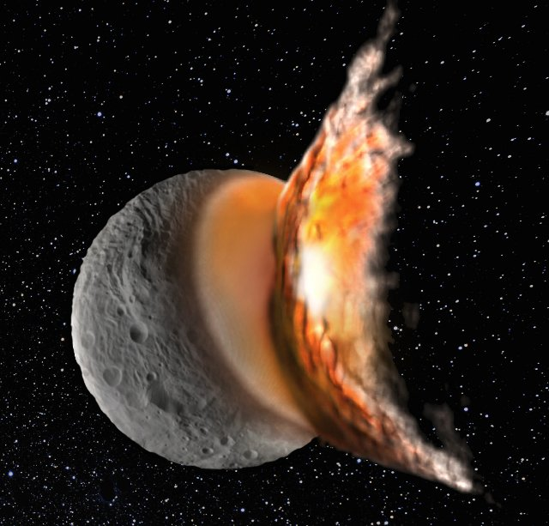
The Rheasilvia Crater was formed less than 1 billion years ago. It shook off 1% of Vesta’s mass and sent meteors around the solar system.

Slide 13
Howardite-Eucrite-Diogenite (HED) meteors come from Vesta. These comprise about 5% of all the meteors that fall to Earth.

Slide 14
The Rheasilvia Crater is about 12 miles deep. In the middle is the tallest known mountain in the solar system.
It is about 16 miles
(82,000 ft) from
base to top.
(Mt. Everest is
5.5 miles tall.)

Slide 15
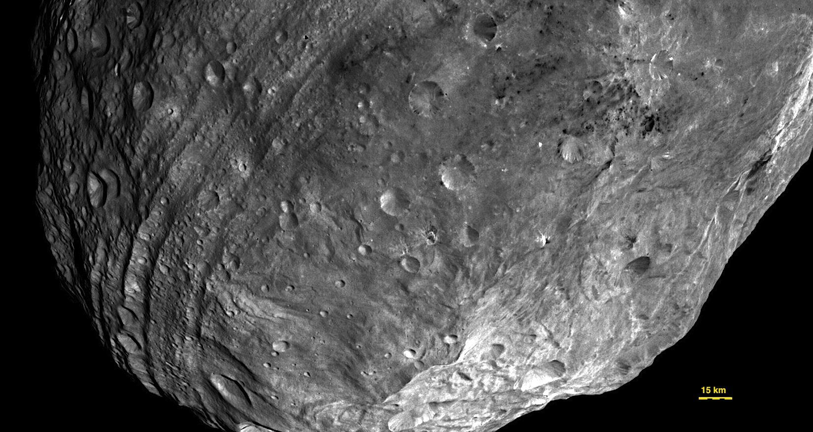
Vesta contains deep grooves & troughs that dwarf the Grand Canyon.

Slide 16
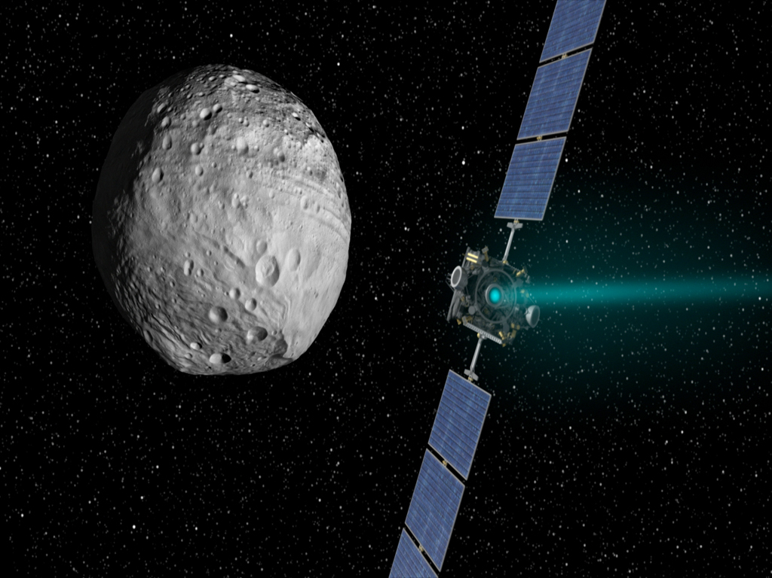
The Dawn spacecraft arrived at Vesta on July 16, 2011. It orbited for a year.
On September 5, 2012, Dawn left and headed for the asteroid Ceres.

Slide 17
